Slide 1

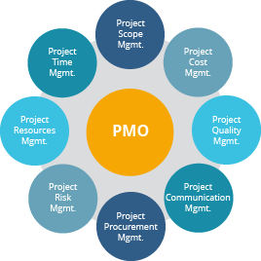
PMO Delivery Process

Slide 2
PMO – Business Agreement
Requesting
Develop a Project Charter
Controls
Review Governance Document guidelines
Create Governance Agreement Document
Prepare
Create business Case
Create Budget Template
Create Project Plan
Review Project Timelines with Governance Agreement Document
This document creates the framework for what will be delivered, any budget scoping and what the final product expectations are.
Agree with the business who will be involved

Slide 3
PMO – Identifying Scope
Understanding
Develop a Requirements Document
Agreeing
Designing
Understand what it will look like
Agree with the business what will be delivered

Slide 4
PMO – Delivering
Build
Develop Work Packages for delivery by team members
Test
Develop UAT Testing Plans
Support
Prepare Support Plans
Reporting schedule weekly
Schedule Meetings
Prepare Training Plans
Gain business agreement with the approval of both documents above.
UAT approval signoff

Slide 5
PMO – Supporting
Completing
Project closure
Change
Create change management plan
Deploy
Create agreed deployment plan
Identify Staff/Management/System/Building requirements
Manage vendor needs
Review - build issues register and review meeting
Lessons Learnt meeting

